Slide 1
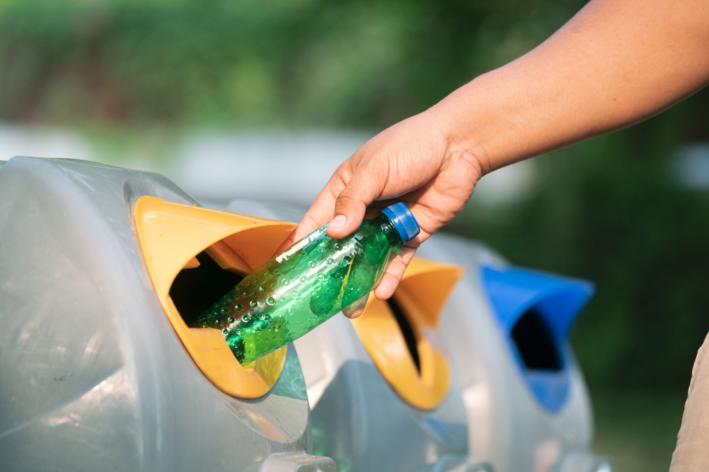
Smart Waste Segregation Management
By :
  Saad Mohammad Shibli
  Anurag Kumar
  Mihir Kumar
  Sudhanshu Ranjan

Slide 2
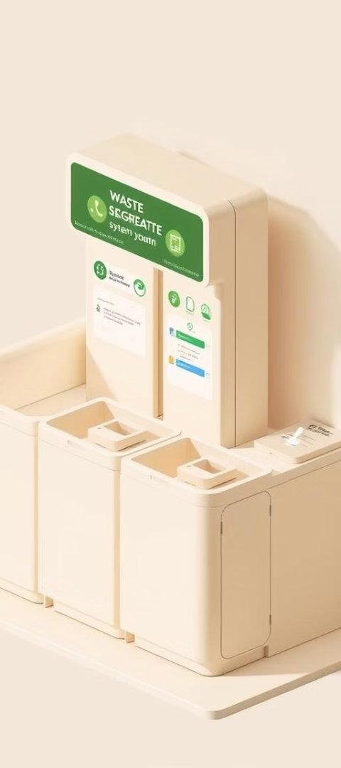




Objectives
Automate waste segregation
Use sensors to streamline the segregation process.
Detect organic waste
Identify organic waste based on moisture content.
Monitor bin fill level
Send alerts to prevent overflow.
Implement future-ready features
Incorporate odor detection for decaying waste.

Slide 3
Problem Statement
Key Issues:
Manual waste sorting is time-consuming and error-prone.
Mixed waste contaminates recycling streams (e.g., organic waste in metal bins).
Goal: Build an automated system to segregate waste into:
  Organic (food, wet waste)
  Ferrous Metals (iron, steel)
  Non-Ferrous Metals (aluminum, copper)
  Non-Organic Non-Metals (plastic, glass)

Slide 4
Working Principle
Detection
1
Sensors, including moisture, ultrasonic, and odor sensors, identify waste type based on conductivity, distance, and gas concentration.
Analysis
2
The Arduino Uno processes sensor data, comparing it against predefined thresholds to determine the appropriate segregation action.
Segregation
3
Based on the analysis, DC and servo motors activate to sort waste into designated containers, ensuring efficient and automated separation.

Slide 5
Sensor Placement Order
Order of Sensors on the Conveyor Belt:
Stage 1: Organic Detection (Moisture + Gas Sensors)
Why first? Organic waste (e.g., food) can contaminate other waste streams if not separated early.
Stage 2: Metal Detection (Inductive Proximity + Hall Effect Sensors)
Why second? Metals are non-biodegradable and valuable for recycling.
Stage 3: Non-Metal Detection (IR Sensor)
Why last? Non-metals (plastic, glass, paper) are classified only after organic/metal removal.
Avoiding Sensor Interference:
Moisture sensors are placed under the conveyor to directly contact waste.
Hall effect sensors are positioned immediately after inductive sensors for sequential metal classification.
Moisture Sensor → 2. MQ-135 → 3. Inductive Proximity → 4. Hall Effect → 5. IR Sensor.

Slide 6
Component Connection and Roles
S.No | Component | Purpose | Arduino Pins | Power Source
1 | Arduino Uno | Main controller | – | USB / 9V–12V Battery
2 | Conveyor Belt (DC Motor) | Moves waste across sensors | IN1 → D10, IN2 → D11, ENA → D12 | 9V–12V (via L298N)
3 | L298N Motor Driver | Controls DC motor | IN1, IN2, IN3, IN4, ENA | VCC → 9V–12V, GND
4 | Soil Moisture Sensor | Detects moisture (organic waste) | AOUT → A0 | VCC → 5V, GND
5 | MQ-135 Gas Sensor | Detects gas (organic waste) | AOUT → A1 | VCC → 5V, GND
6 | Inductive Proximity Sensor | Detects all metals (ferrous/non-ferrous) | OUT → D3 | VCC → 5V, GND
7 | Hall Effect Sensor | Detects ferrous metals (iron, steel) | OUT → D4 | VCC → 5V, GND
8 | Ultrasonic Sensor (HC-SR04) | Detects bin fill level | Trig → D5, Echo → D6 | VCC → 5V, GND
9 | Stepper Motor (with ULN2003) | Rotates bins under the sorting flap | IN1 → D7, IN2 → D8, IN3 → D9, IN4 → D13 | VCC → 5V, GND
10 | Servo Motor | Opens bin when full | Signal → D2 | VCC → 5V, GND
11 | Buzzer | Alerts when bin is full or error | + → D14 (or A2), – → GND | –
12 | Battery (9V/12V) | Powers Arduino and motors | + → Vin, – → GND | Main Power Supply

Slide 7
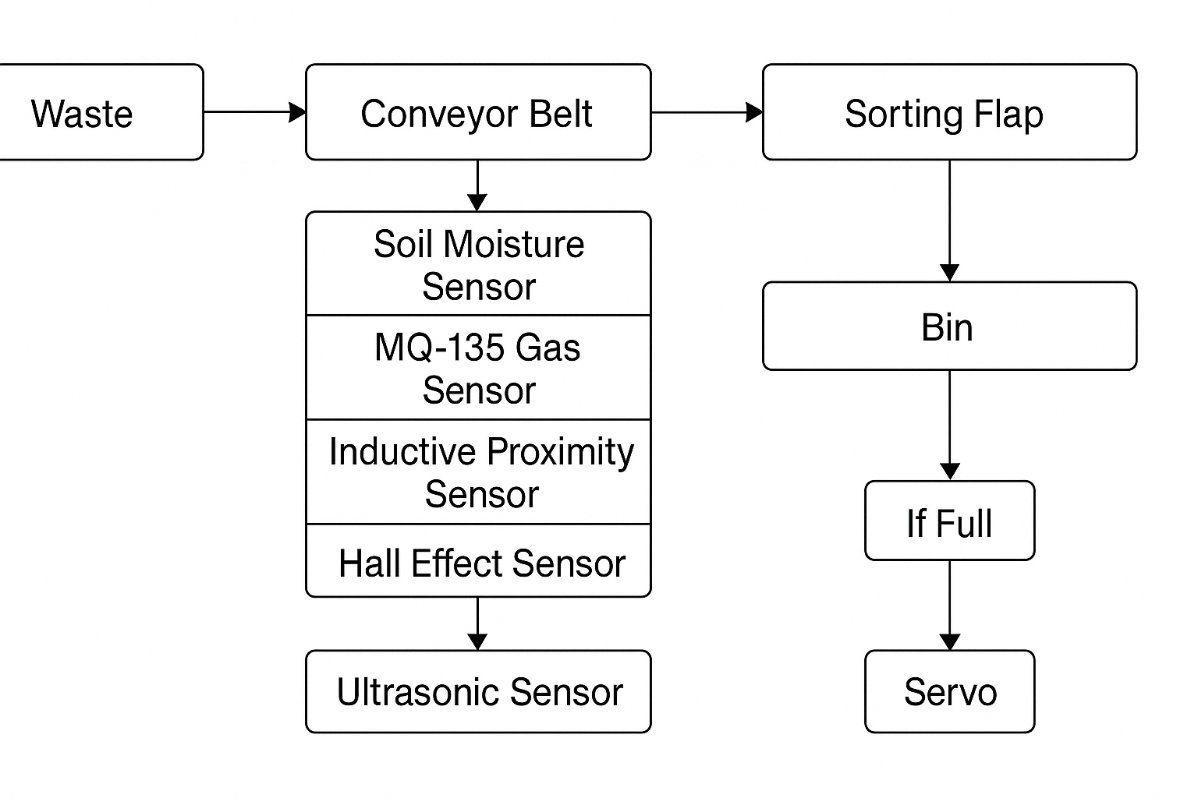
System Overview (Block Diagram)
Stepper Motor

Slide 8
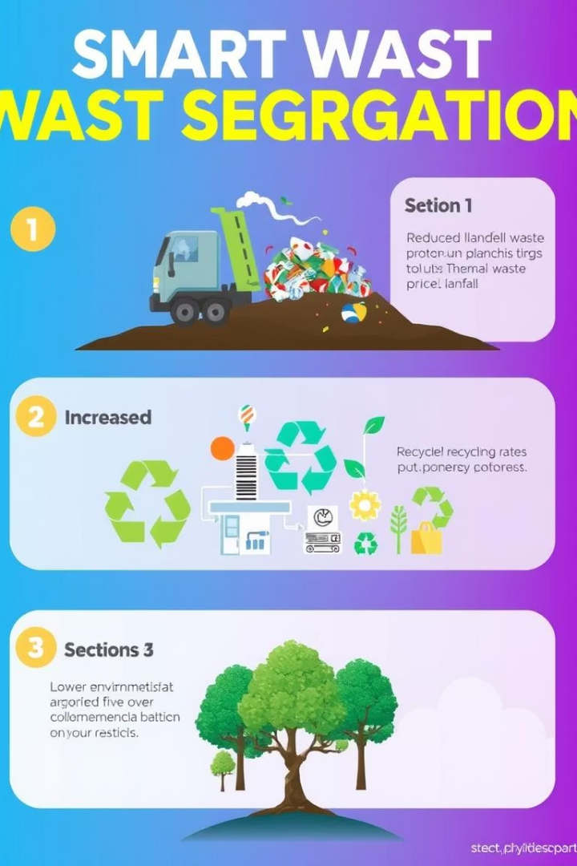
Benefits of Waste Segregation Management System
60%
30%
Reduction in landfill waste
Increase in recycling rates
20%
Lower environmental impact

Slide 9
Future Scope
Mobile app for real-time monitoring
Solar-powered system for off-grid use
Advanced AI-based image classification for object detection
Integration with municipal waste management systems

Slide 10
Conclusion
Smart waste segregation saves time and improves hygiene
Added features make it practical, scalable, and innovative
Suitable for homes, institutions, and public areas

